Slide 1
ECE 530 Cloud Computing
Ioannis Papapanagiotou
Scaling Data systems on the Cloud

Slide 2
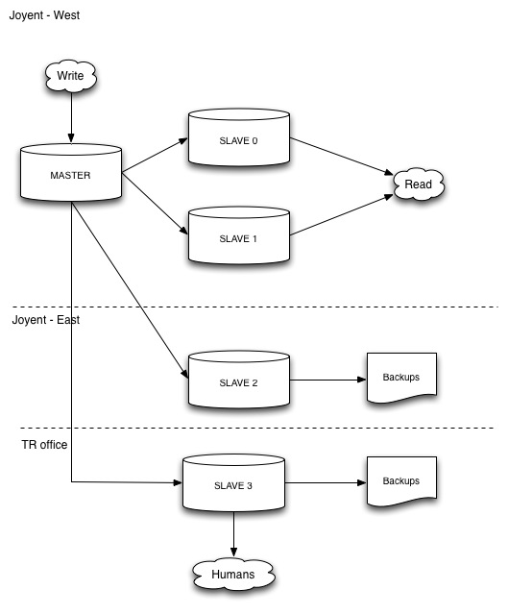
Remember When…?
In early 2000s, read scaled out by adding replication slaves to a Master DB
Writes went to a single master, reads when to the slaves.
Slaves could lose transactions

Slide 3
Problems of RDBMS on the Cloud
At small scale, things are OK
Having a single node to write data, the node can become overloaded with high write throughput.
Nodes can be terminated or restarted by the Cloud provider.
RDBMS are CP systems (per the CAP theorem). Hence when the master node gets terminated, we need to re-elect a new master node. This result is down time.
Due to the growth of online platforms (e.g. Facebook, Instagram, Twitter etc) and machine learning algorithms, there are a lot more data that are being generated by online users.

Slide 4

C* Replication & Consistency
One of the most famous implementations of the Dynamo protocol is Cassandra (or else C*)
C* is a multi-master system
C* is eventually consistent
It WILL get here… eventually
Eventually is not:
A day from now
A minute from now
A second from now
In many cases it is milliseconds

Slide 5
History of Cassandra

Slide 6
C* Replication

Slide 7
Cassandra features

